Slide 1
ACA Reporting: Preparing for 2016 Deadlines
Bradley Arends Alliance Benefit Group Financial Services, Corp.
Stacey Rice Cargill, Incorporated
Liz Deckman Holly Fistler Melinda Maher Bob Seng Dorsey & Whitney LLP
July 13, 2015

Slide 2
Add Dorsey ERISA blog link Tweet this event at #dorseyACA Follow us on Twitter using: @dorseyERISA

Slide 3
A few updates
NEWS FLASH: More ACA rules delayed …!!!!
King v. Burwell
Black/Thompson (HR 2712)
Warner/Portman

Slide 4
Pieces of ACA especially relevant for today
Employer Shared Responsibility Provisions (Employer Mandate)
Individual Shared Responsibility (Individual Mandate)
Subsidies / Premium Tax Credit

Slide 5
Agenda for Today
Administration & Workflow for ACA reporting
1094-C
Controlled groups, Applicable Large Employers, ALE Members, Aggregated ALE Groups
Authoritative Transmittals
Line 22
1095-C
Line 14
Line 15
Line 16

Slide 6
Administration & Workflow
Payroll vendor or system
HRIS
COBRA administrator
Health Plan TPA
ACA reporting vendor
Build a grid?
BAAs?

Slide 7
1094-C – Cover Sheet
The 1094-C demonstrates compliance with the Employer Mandate
The 1094-C serves as a Transmittal form for individual Forms 1095-C when they go to the IRS
The 1094-C contains Controlled Group / Aggregated Large Employer Group information for the IRS

Slide 8
Foreshadowing – 1095-C
The 1095-C is a little like a Form W-2
An employer subject to ACA will issue several Forms 1095-C to certain individuals
The employer also files the Forms 1095-C with the IRS, using the 1094-C as a cover page
Individual demonstrates compliance with Individual Mandate to IRS
Information to IRS on offers of coverage that may affect subsidy eligibility

Slide 9
Compare & Contrast

Slide 10
1094-C – Find Your Controlled Group
“Controlled group” is an IRS term used to describe companies under common control.

Slide 11
1094-C – Controlled Groups
Controlled Groups come in a few flavors
Parent – Subsidiary
Brother – Sister
Affiliated Service
Combinations of these

Slide 12
1094-C – Controlled Group Tips
Talk to your tax people
Look at your IRS determination letter filings for qualified retirement plans

Slide 13
1094-C – Controlled Group Tips
Individuals, trusts, partnerships that own groups of companies (brother-sister)
Churches or government institutions with various operations (good faith interpretation)
Groups of companies that or partnerships that provide services to each other (affiliated service groups)

Slide 14
1094-C – Controlled Groups to Aggregated ALE Groups
Any controlled group with an average of 50 or more FTEs on business days in 2014 is an “Aggregated ALE Group” for 2015

Slide 15
1094-C – What it Means to be an Aggregated ALE Group
Aggregated ALE Groups are subject to the Employer Mandate in 2015
Aggregated ALE Groups are subject to ACA reporting for 2015 calendar year
See 1094/1095-C instructions at page 9 for a definition of “Aggregated ALE Group”

Slide 16
1094-C – Aggregated ALE Group
This is an Aggregated ALE Group
Parent
(3 employees)
Division A
(75 employees)
wholly- owned LLC
(50 employees)
Subsidiary
(376 employees)
Subsidiary
(IP holdings – no employees)

Slide 17
Aside – It’s 2015. Where are your Employees
We are looking for common law employees
Leased
Seasonal
Etc.

Slide 18
1094-C – ALE Member
An “ALE Member” is a Member of an Aggregated ALE Group that:
Has its own EIN
Has 1 or more employees

Slide 19
1094-C – ALE Member Responsibilities
Each “ALE Member” is responsible for filing a Form 1094-C.
Some “ALE Members” may file multiple Forms 1094-C, but one of those forms should be the “Authoritative Transmittal.”

Slide 20
1094-C – Aggregated ALE Group
Find the ALE Members
Parent
(3 employees)
Division A
(75 employees)
wholly- owned LLC
(50 employees)
Subsidiary
(376 employees)
Subsidiary
(IP holdings – no employees)

Slide 21
1094-C Aggregated ALE Group

Slide 22
1094-C – Applied Learning

Slide 23
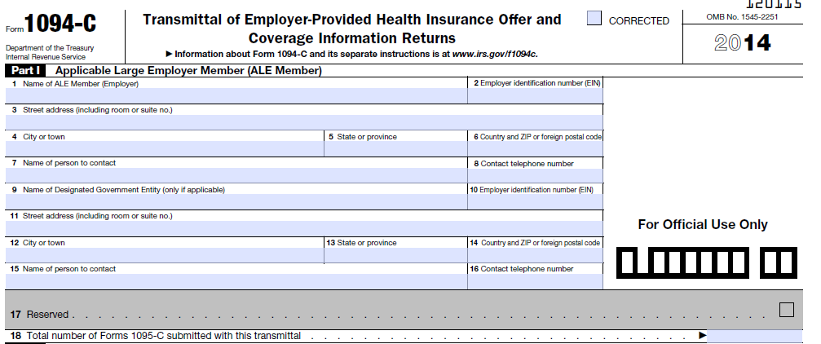
1094-C, Part I
EIN

Slide 24
1094-C, Part II, Lines 19-21
Each ALE Member files 1 “authoritative transmittal”
same as controlled group
Part IV is a list of controlled group members

Slide 25
1094-C, Part II, Line 22

Slide 26
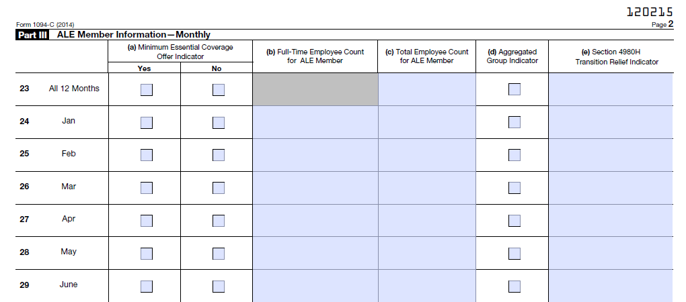
1094-C, Part III

Slide 27
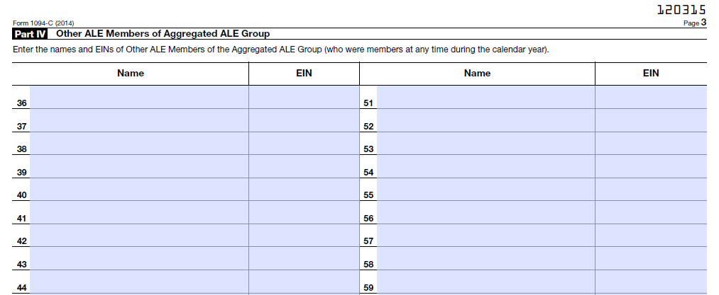
1094-C, Part IV
This is a list of “ALE Members,” aka, your controlled group.

Slide 28
Cleanse the Palate (healthyeating.sfgate.com)
Crackers
Lemon sorbet
Pickled ginger
Milk

Slide 29
And Start Thinking About Form 1095-C
Like a W-2
Shows whether offer of coverage has been made
Employer Mandate
Subsidies
Filed with the IRS
Distributed to Employees

Slide 30
1095-C / Some Terms & Rules
Rules for identifying full-time employees
Monthly measurement period
Look-back measurement period
Initial measurement period
Standard measurement period
Stability period
Limited Non-Assessment Period
Multiemployer interim rule relief
Qualifying Offer

Slide 31
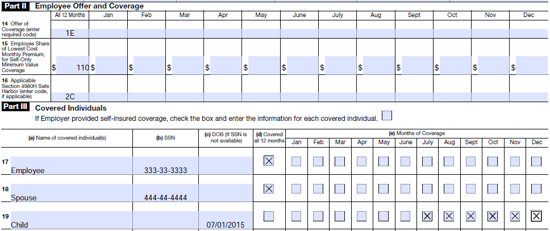
Examples – Form 1095-C, Lines 14-16
Ongoing full-time employee
Employee and spouse enrolled in minimum value self-insured plan all year; child added in July
Self-only, minimum value coverage is $110/month

Slide 32
Examples – Form 1095-C, Lines 14-16
Newly hired full-time employee
Employee hired March 15th
Waiting period: employees eligible on 1st of month after 60 days of employment
“Qualifying Offer” made on June 1st
Not offered coverage
Offered coverage
Not yet an employee
Waiting period
Enrolled in coverage

Slide 33
Examples – Form 1095-C, Lines 14-16
Newly hired variable hour employee
Employee hired March 15th with variable schedule
Initial measurement period March 15, 2015 through March 14, 2016
No Form 1095-C for 2015 – not (yet) a full-time employee
[No Form 1095-C for 2015]

Slide 34
Examples – Form 1095-C, Lines 14-16
Newly hired variable hour employee (cont’d)
Employee averages 32 hours/week
No waiting period; employee is eligible first of month following end of initial measurement period
Form 1095-C for 2016:
Not offered coverage
Offered coverage
Initial measurement period
Enrolled in coverage

Slide 35
Examples – Form 1095-C, Lines 14-16
Terminated employee
Employee waived coverage at open enrollment
Self-only, minimum value coverage is $110/month
Employer set employee contributions using W-2 safe harbor
Employment terminated on August 15th; plan offers coverage through date of termination
Offered coverage
Not offered coverage
Offer satisfies safe harbor
Employed part of Aug.; then not an employee

Slide 36
Examples – Form 1095-C, Lines 14-16
Terminating employee elects COBRA coverage
Employee, family enrolled in minimum value coverage
Self-only, minimum value coverage is $110/month
Employment terminated on July 20th; plan offers coverage through date of termination
COBRA offered and accepted for family; $300/month for single coverage
Offered coverage
Employee premium
COBRA premium

Slide 37
Examples – Form 1095-C, Lines 14-16
Reduction in hours (Monthly Measurement)
Employee, family enrolled in minimum value coverage
Self-only, minimum value coverage is $110/month
Employee goes to part-time hours in August; coverage terminates end of July
COBRA offered waived; $300/month for single coverage
Offered coverage
Enrolled in coverage
Not enrolled; part time employee

Slide 38
Examples – Form 1095-C, Lines 14-16
Reduction in hours (Look Back Measurement)
Variable hour employee, family enrolled in minimum value coverage
Self-only, minimum value coverage is $110/month
Employee goes to part-time hours in August; coverage continues through end of stability period
Offered coverage
Enrolled in coverage

Slide 39
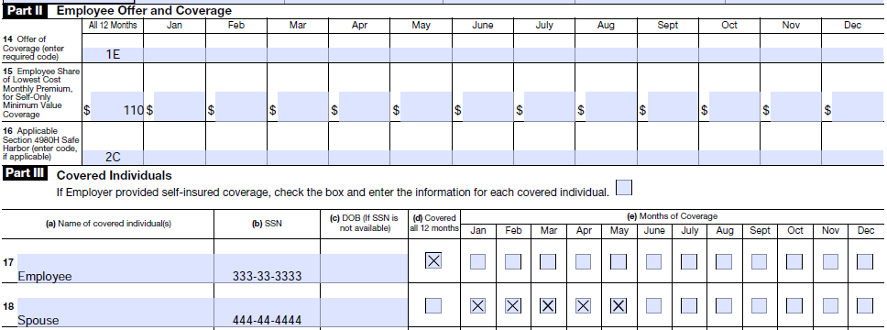
Examples – Form 1095-C, Lines 14-16
COBRA coverage for non-employee
Employee and spouse enrolled in minimum value coverage; divorce on May 15th
For January through May, spouse reported on employee’s Form 1095-C

Slide 40
Examples – Form 1095-C, Lines 14-16
For June through December, former spouse receives separate Form 1095-C

Slide 41
Form 1095-C, Part III
Do I really need SSNs?
Rules for checking boxes

Slide 42
Questions
Elizabeth Deckman Dorsey & Whitney │Seattle Partner (206) 903-2419 deckman.liz@dorsey.com
A. Melinda Maher Dorsey & Whitney │Minneapolis Partner (612) 492-6082 maher.melinda@dorsey.com
Bob Seng Dorsey & Whitney │Minneapolis Partner (612) 492-6071 seng.bob@dorsey.com
Holly A. Fistler Dorsey & Whitney │Minneapolis Associate (612) 492-6072 fistler.holly@dorsey.com
Tweet this event @dorseyERISA. Follow us on Twitter using #dorseyACA.

